Slide 1
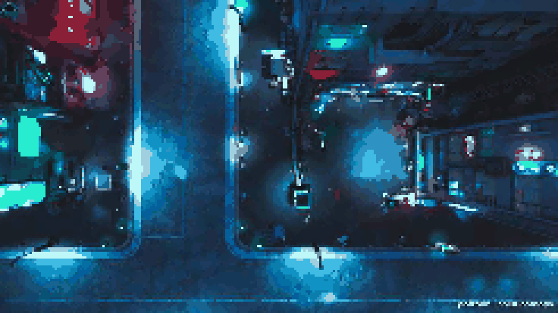
Mecha Mayhem

Slide 2
Elevator Pitch
Suit up in Mecha Mayhem within this 2D bullet hell roguelike game in the future. Control your mech to navigate your way through enemies' patterns, analyze them, defeat them, and upgrade your mech to survive and fight.

Slide 3
Gameplay
Move around in a Top-Down Perspective Map
Pick Up Weapons dropped by Enemies to Fight Back

Slide 4
Gameplay Loop
Fight monsters
Pick up / Upgrade weapons
Progress Levels

Slide 5
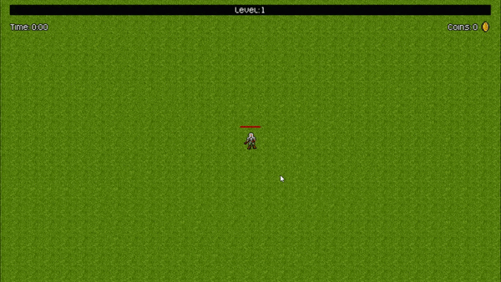

Slide 6
USPS
Steal Enemies Weapons to Fight Back With
More Powerful Enemies = More Powerful Weapons
Eye pleasing 16-bit graphics alongside a Sega Genesis soundfont.
Multiple genres in one mixed with mecha, roguelike, bullet hell, and 2D

Slide 7
Target Audience
People who like bullet hell roguelike games
People fan of the Mecha genre in video games or anime

Slide 8
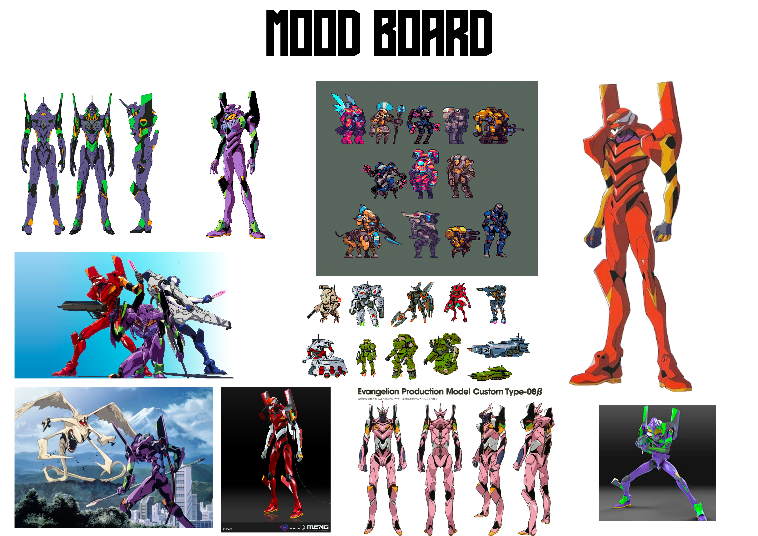
Aesthetics

Slide 9
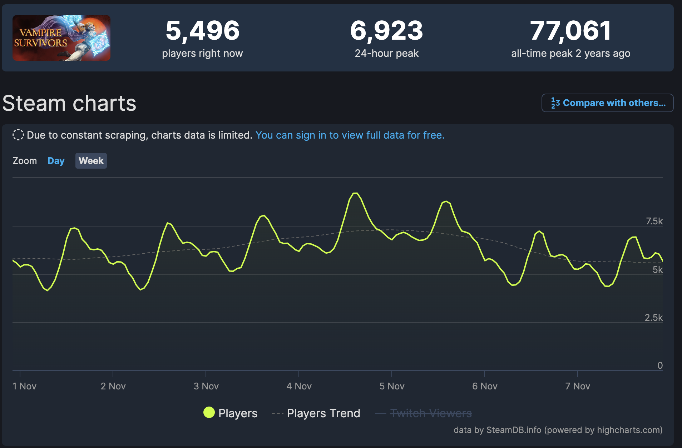
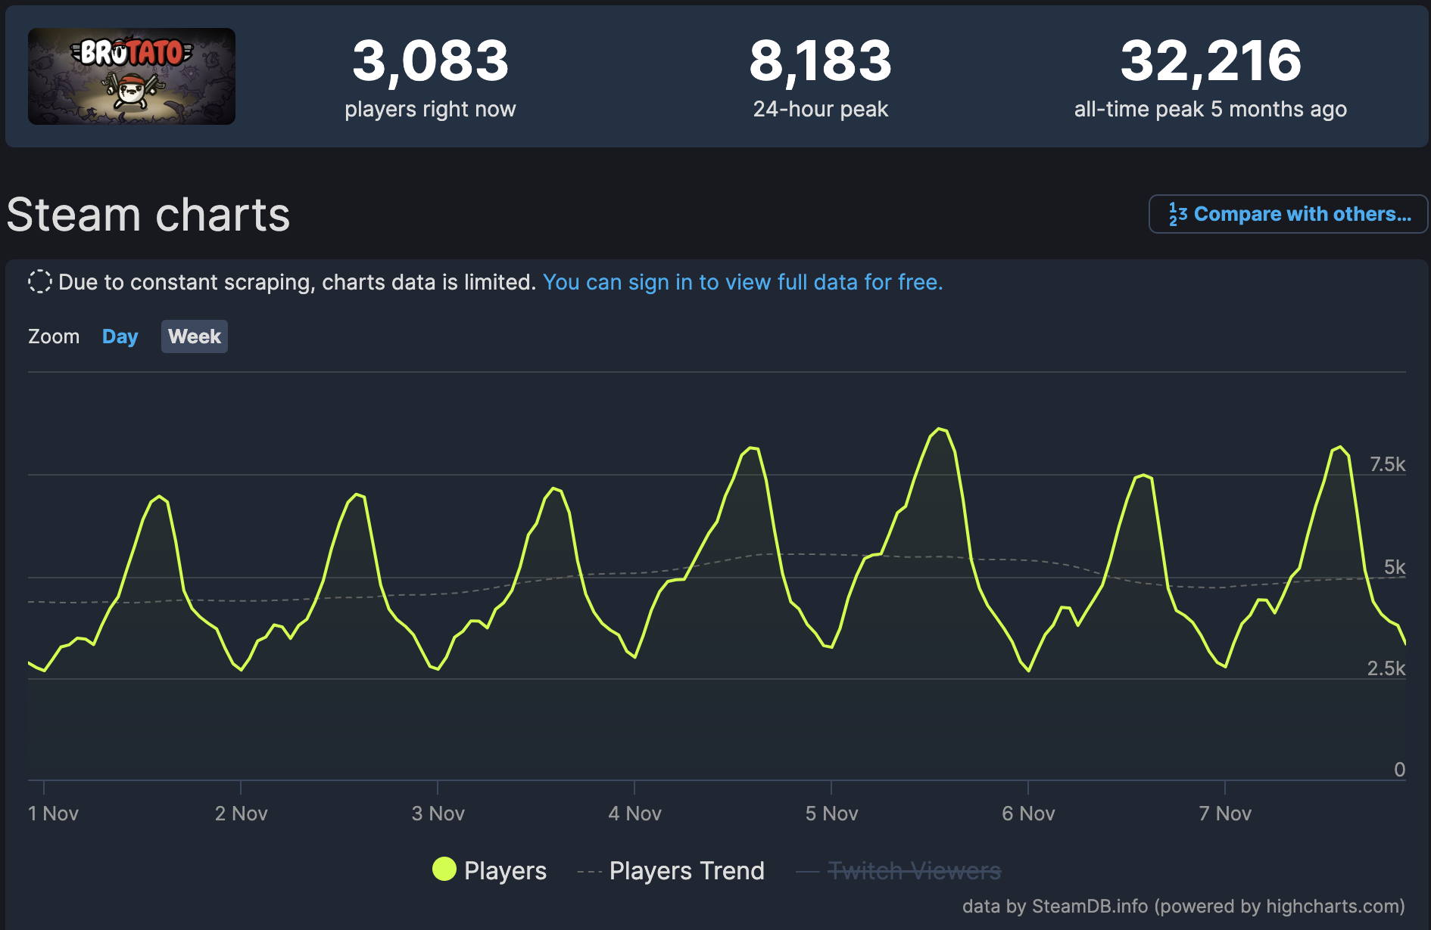
Marketing
99 games under tags of bullet hell and mechs
9 games under tags of 2D, roguelike, bullet hell, and mechs
Attracting roguelike players who like mechs

